Slide 1
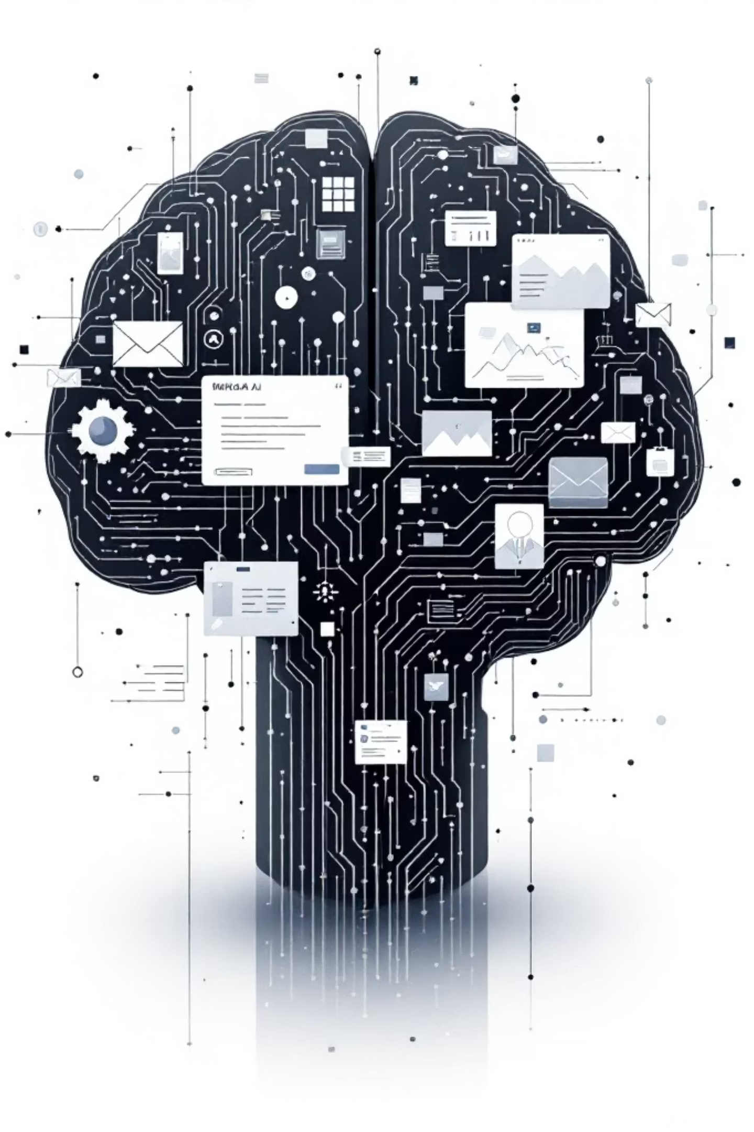
CLIP: Connecting Vision and Language
Understanding Multimodal AI

Slide 2

What is Multimodal AI?
Multimodal AI systems are designed to process and understand information from multiple types of data, or "modalities," simultaneously. Just as humans use various senses to perceive the world, multimodal AI integrates different data forms to gain a richer, more comprehensive understanding.
Image + Text
Audio + Text
Video + Language
Analysing visuals alongside descriptive language.
Processing spoken words with their transcriptions.
Interpreting dynamic visuals with accompanying narration or text.

Slide 3
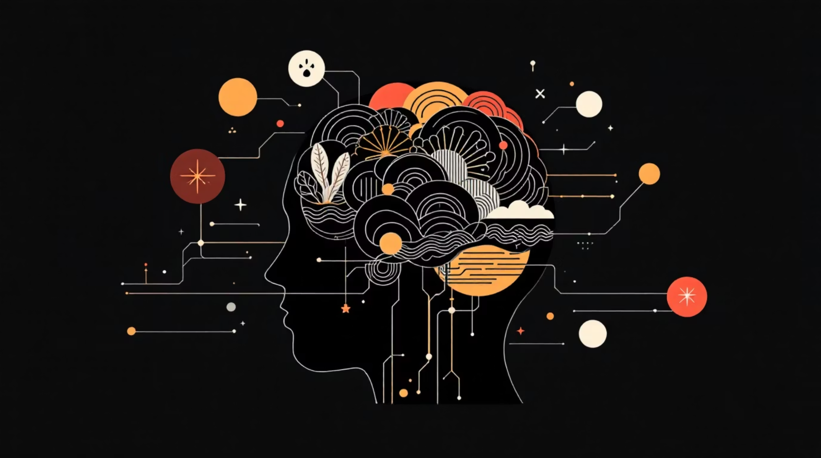
Why Multimodal AI is Important
Bridging the Gap
Traditional AI often excels in single domains, but the real world is inherently multimodal. Humans naturally combine senses, like sight and hearing, to interpret complex situations.
Enhanced Understanding
By integrating multiple data types, AI can overcome the limitations of single-modal systems, leading to more robust and accurate interpretations. This mirrors our own cognitive processes.

Slide 4

The Core Problem: Disparate Representations
Images and text, despite often describing the same concepts, exist in fundamentally different digital formats. AI systems historically struggle to inherently connect the rich visual meaning of an image with the abstract semantic meaning of language.
?
Large gap illustrating the connection challenge.
Image Space
Text Space
Visual features and rich semantics.
Symbolic descriptions and linguistic structure.
This challenge creates a significant barrier to achieving human-like comprehension, necessitating a method for AI to build a shared understanding between these diverse modalities.

Slide 5

What is CLIP?
CLIP stands for Contrastive Language–Image Pretraining. It's an innovative neural network developed by OpenAI designed to learn visual concepts from natural language supervision.
"CLIP efficiently learns visual concepts from natural language supervision. It can be applied to any visual classification benchmark by simply providing the names of the visual categories to be recognised, similar to the "zero-shot" capabilities of GPT-2 and GPT-3."
Essentially, CLIP learns the relationship between images and the text that describes them, drawing knowledge from a vast amount of publicly available data.

Slide 6

High-Level Architecture: Shared Embedding Space
Embedding Space
Image
Shared high‑dimensional space
Raw visual input
Text Encoder
Shared Embedding Space
Item
Maps text to vector
Text
Image Encoder
Raw textual input
Maps image to vector
At its core, CLIP uses two independent components: an image encoder and a text encoder. These encoders process their respective inputs and map them into a shared, high-dimensional embedding space. In this space, semantically similar image and text pairs are located close to each other.

Slide 7
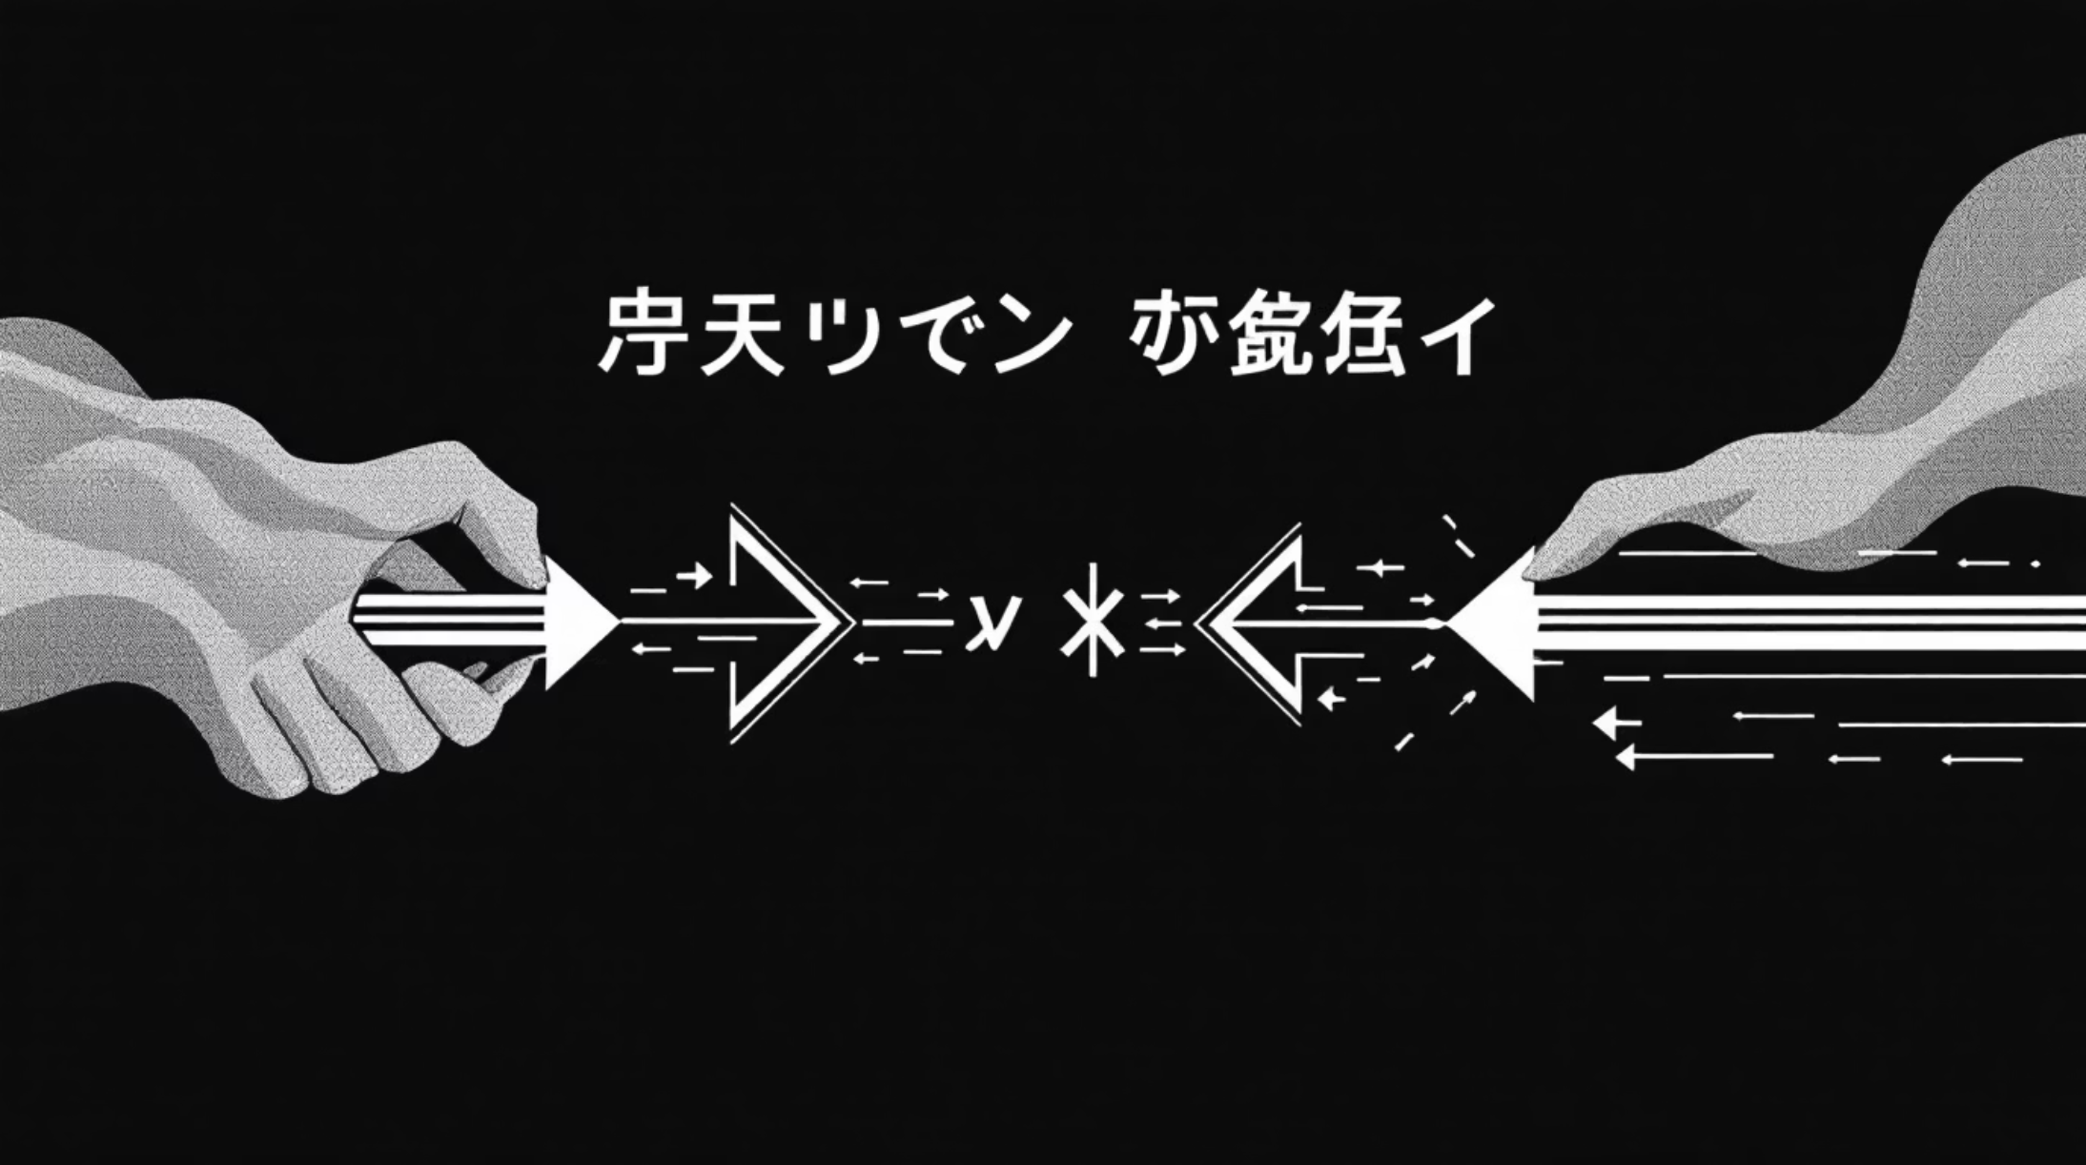
Contrastive Learning: The Intuition
The magic of CLIP lies in its contrastive learning approach. During training, CLIP is presented with pairs of images and text descriptions.
Match & Mingle
For correctly matched image–text pairs, the model is trained to pull their representations closer together in the shared embedding space.
Separate & Distinguish
Conversely, for non-matching pairs (e.g., an image of a cat with a description of a dog), the model learns to push their representations further apart.

Slide 8
How CLIP is Trained
CLIP's training is a monumental feat of machine learning, relying on a simple yet powerful premise:
01
02
03
Vast Dataset
No Manual Labels
General Concepts
Trained on hundreds of millions of publicly available image-text pairs from the internet.
Crucially, it requires no human-annotated labels, learning directly from the natural captions accompanying images.
This enables CLIP to learn a broad spectrum of visual and linguistic concepts, understanding what objects look like and how they are described.
This self-supervised learning paradigm allows CLIP to develop a robust and flexible understanding of the visual world.

Slide 9
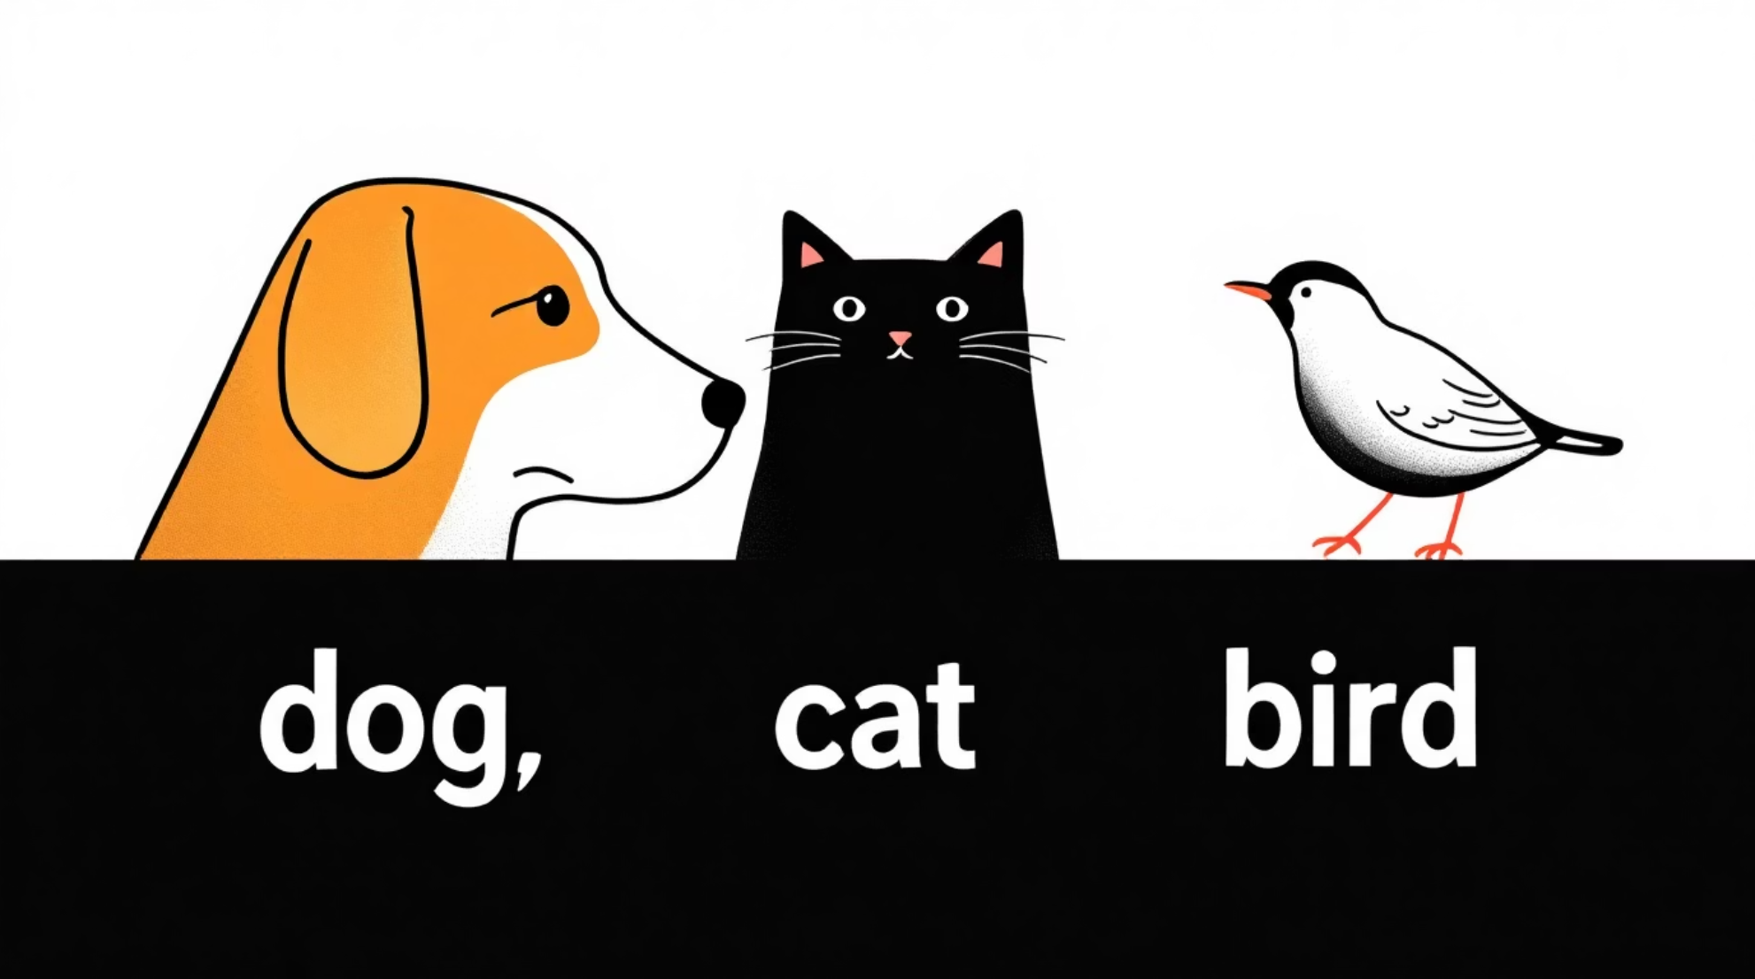
The Power of Zero-Shot Learning
Classify Without Retraining
One of CLIP's most impressive capabilities is zero-shot learning. It can classify images into categories it has never explicitly seen during training.
How it Works
You provide an image and a set of text prompts (e.g., "a photo of a car," "a photo of a truck"). CLIP then determines which prompt best matches the image based on their proximity in the embedding space.
Why It's Powerful
This eliminates the need for expensive, task-specific labeled datasets and opens up vast possibilities for flexible, on-the-fly image classification and retrieval.

Slide 10
Key Takeaways
Aligns Vision & Language
Enables Zero-Shot Learning
Foundation for Multimodal AI
CLIP creates a shared understanding between images and text, bridging a critical gap in AI.
It can classify novel concepts without explicit retraining, demonstrating remarkable generalisation.
CLIP serves as a fundamental building block for many advanced multimodal AI systems, driving innovation in the field.

